Slide 1
Shore Sweep
A new desktop admin for TrashOut

Slide 2
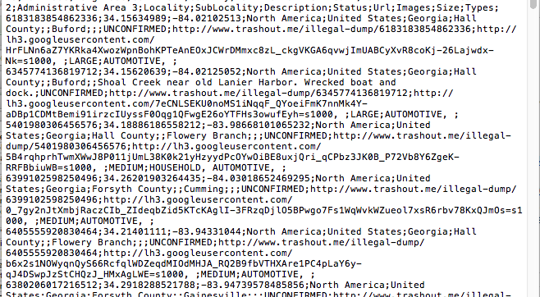
Shore Sweep Admin
Scope: Create a web based shore sweep administration interface that starts with a TrashOut Data export
7001. Admin can import data into a shoresweep admin app from trashout via a trashout export and shoresweep import feature
7101. Trashout export will include existing records. Once uploaded the first time, shoresweep will be the System of record, simply ignoring records from the upload file that were previously imported.

Slide 3

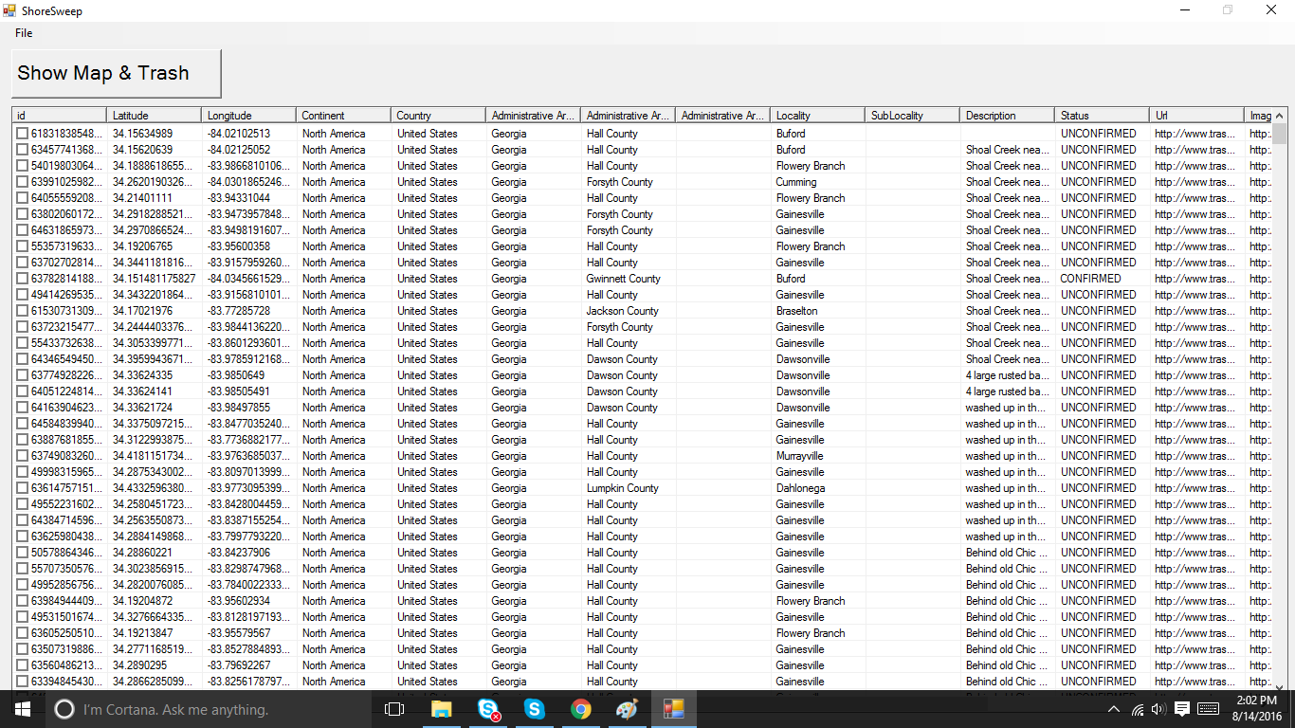
Administration – Desktop Web App – Record Management
Shore Sweep
4201. Admin can change the state of any item . Available states are Unconfirmed, Confirmed, Cleaned
4301. Admin can set or edit the administrative area, locality or “section” of any item to manage groups responsible
4401. Admin can set or edit the “assignee” of any item from a preset list of assignees
4501. Admin can view the photo URL of any item
4601. Admin can view the last updated date of any item
4701. Admin can sort all records by clicking on any column heading
4801. Admin can bulk edit any number of items by selecting any combination from the left check box and choosing an edit option
4901. Admin can view the Update record screen by clicking on the checkbox ID of any item and choosing “show map and trash”

Slide 4
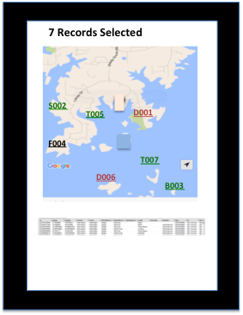
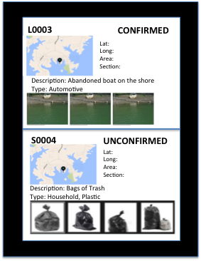
7201. Admin can generate a printable PDF of each individual record including:
ID #
Pictures
State
Map view
Last comment
Admin can select records and print any collection of records with a single operation
by selecting multiple records and choosing “show map and trash”
7301. When admin chooses “show map and trash” system will generate a multi-page printable list/ map view of all items selected as follows:
Page 1 – Summary view including:
Summary map of all selected items
Items marked with ID #
Items color coded by state
Summary list of all selected items including:
ID#
State
Section
Description/comment
Type
Assignee
Address or GPS coordinates
Pages 2-n
2 items per page including the following for each:
Map view of item
ID#
State
Section
Description/comment
Type
Assignee
Address or GPS coordinates

Slide 5
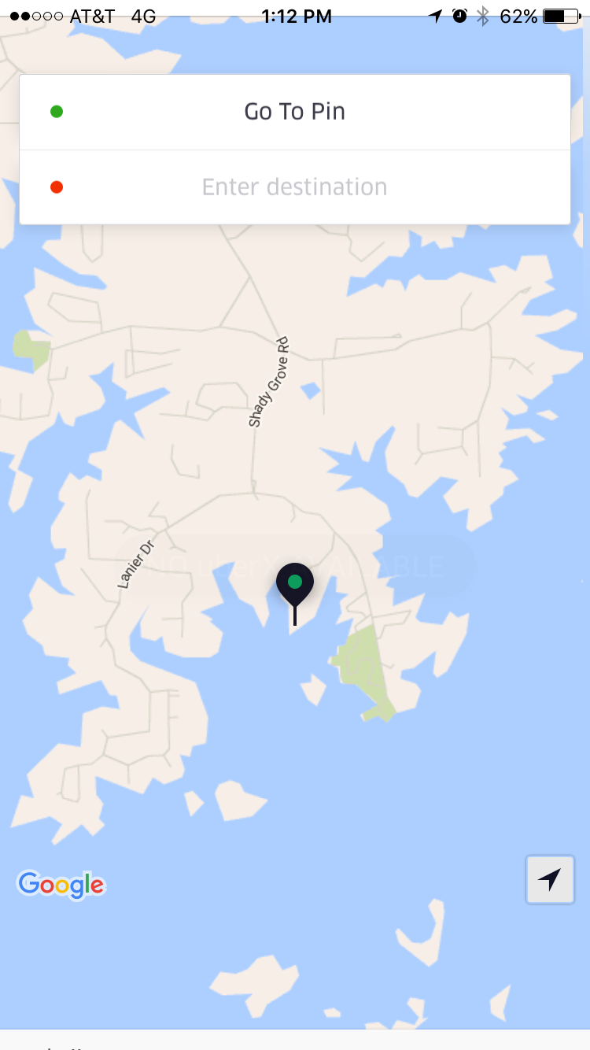
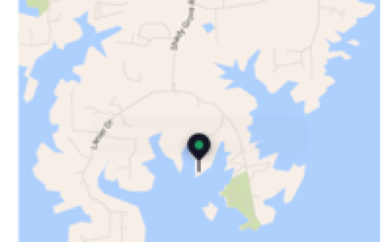
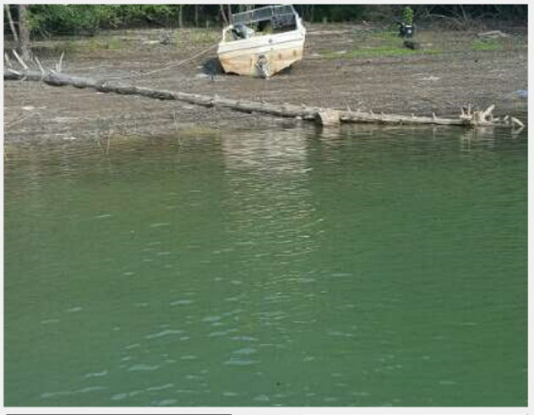
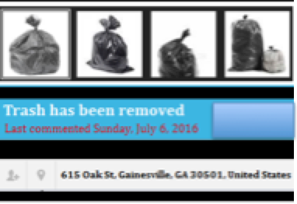
Page 1
Pages 2-n
7 Records Selected
L0003
CONFIRMED
Lat:
Long:
Area:
Section:
Assignee:
S002
Description: Abandoned boat on the shore
Type: Automotive
T005
D001
F004
T007
S0004
UNCONFIRMED
D006
B003
Lat:
Long:
Area:
Section:
Assignee:
Description: Bags of Trash
Type: Household, Plastic

Slide 6
Encoding Key info into the ID Number
Types:
Household
Automotive
Construction
Plastic
Electronic
Glass
Metal
Liquid
Dangerous
Sizes:
Small
Medium
Large
Since trashout has 9 different “types” of trash, and any record can be any combination of these 9, its not practical to encode the “type” into the ID number
We can, however, encode the “size” with the first letter of the ID, as follows:
S0001 = Small item #1
M0002 = Medium Item #2
L0001 = Large item #1

Slide 7
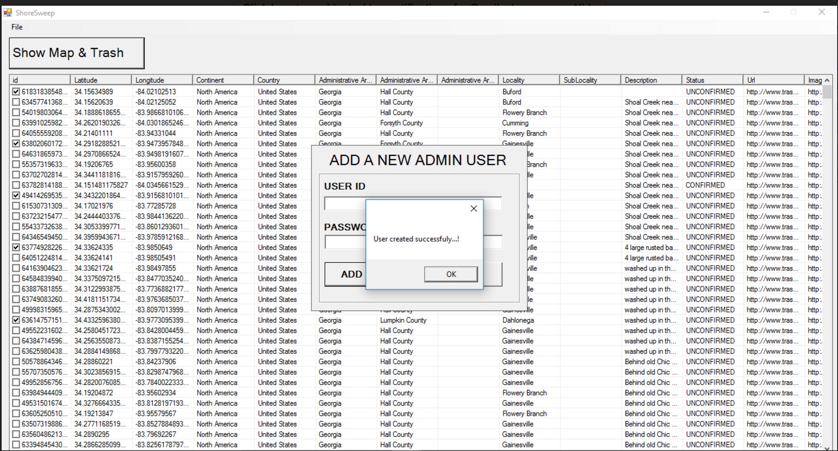
7401: Ability to add a new admin

Slide 8
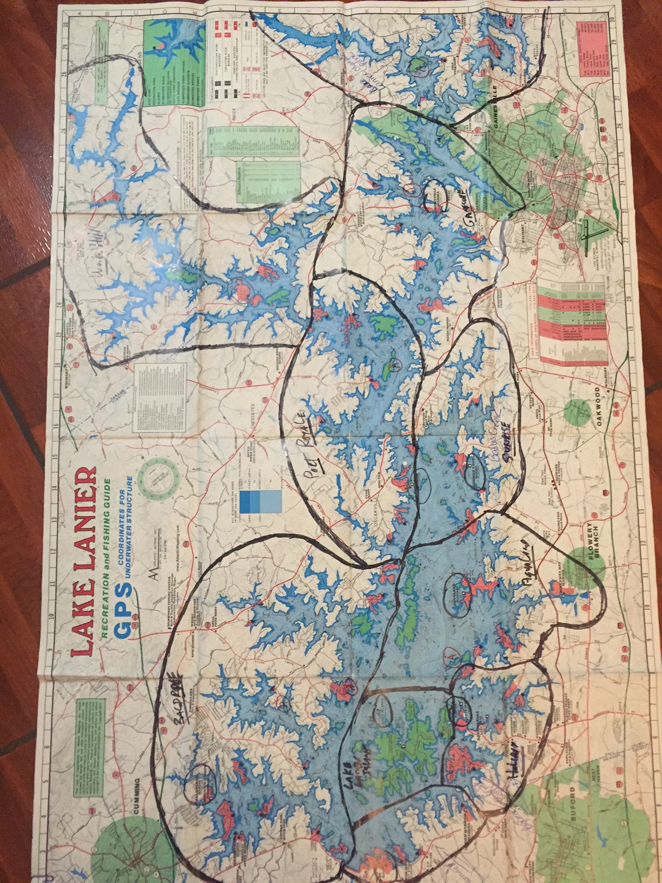
8101: Ability to draw and define areas on the map by drawing polygons as shown here:
http://www.birdtheme.org/useful/v3tool.html
8201: Ability to check if a recorded lat/long exists in a defined polygon on the map using something similar to what is described here:
http://stackoverflow.com/a/16675416
8301: If Record Lat/Long exists in defined polygon, record the name of the polygon as “Area” or “Section”
Here is a drawing of the map with areas defined:

